Slide 1

GridWorld Technologies

Slide 2
SUPER PaCed Software

Slide 3

SUPER OTHELLO GAME!!!
By Charlie Huang and Patrick Lee

Slide 4
What is Super Othello?
Play by yourself and hone your skill against AIs ranging from easy to hard, to even impossible!
Or challenge friends to both locally and on the other side of the room for an exciting match!
Super Othello is the classic board game, Othello, brought to your computer!

Slide 5
Gameplay
Hard AI plays just like an advanced player, calculating your moves in advance and countering
Medium is like a developing player, figuring out the moves with the most immediate benefit
Super Othello single-player is fun, fast, and provides a challenge to players of all skill levels
IMPOSSIBRUU!!! mode just flat out cheats so you can’t win. If you try to win, you lose.
Easy mode plays just like a newbie: randomly and hoping for the best
Is that a challenge?
OF COURSE IT IS!

Slide 6
Multiplayer
Whether they’re right next to you, or all the way across the CS room, you can always enjoy a good match against friends!
Like any good game, Othello is more fun with friends
Super Othello brings that competitive spirit with local networking capabilities

Slide 7
Style
Super Othello’s simple aesthetic, clean user interface, and spare board provide a cool 1998 feel
Comes in a simple .jar file that doesn’t require eclipse to play!!!
Menus are easy to use, intuitive, and simple
Helpful tips on how to play are always available

Slide 8
System Requirements
You must be able to run your computer
Your computer must have JRE 6.0 or higher
Your computer must not be infected with gremlins
Your computer should be connected to a local network if you want to play a networked game

Slide 9
Buy it now!
Small fee of one (really tasty) cookie per developer, or a Mexican Coca-cola
Simply download the executable jar and run it.

Slide 10
Meet The Devs

Slide 11
Patrick Lee-Project Manager/Developer
Wrote MediumAI
Cleaned up GUI and added PlayLevels
Added Help menu in the game
Implemented Networking
Debugger
Wrote all the documents

Slide 12
Charlie Huang-Code Developer
Coded HardAI and Impossibru AI
Guided Project Direction and Game Design
Main tester, wrote most of the JUnits
Tweaked little bits of code to improve the AIs and look of the game

Slide 13
Development
Process

Slide 14
What went well
MediumAI coding
Sharing dropbox
PickLevels GUI
JUnit tests
Cleaning up the GUI
Changing the display

Slide 15
What did not go so well
Networking
Understanding of minimax

Slide 16
What would you change?
Better monitoring of team member’s performance

Slide 17
Under the Hood

Slide 18
Class Structure
OthelloRunner
PickLevels
OthelloPlayer
OthelloWorld
OthelloGame
MediumAI
HumanOthelloPlayer
NetworkWorld
NetworkGame
MinimaxAI
StupidOthelloComputer
ImpossibruAI
Subclass of
Instantiates and Uses

Slide 19
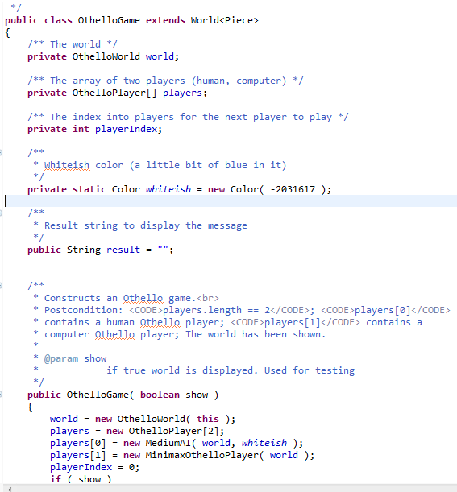
OthelloGame
OthelloGame controls the game
It has the world and the players

Slide 20
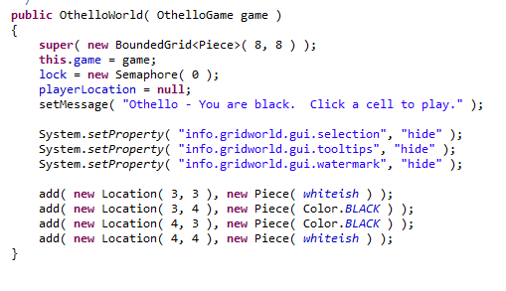
OthelloWorld
OthelloWorld sets up the game

Slide 21
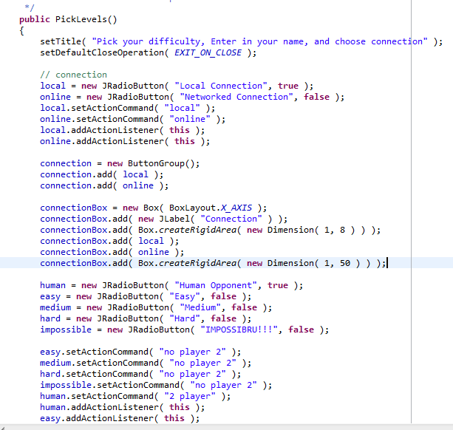
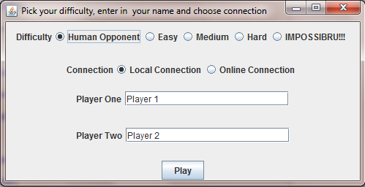
PickLevels is the GUI to select your level and connection

Slide 22
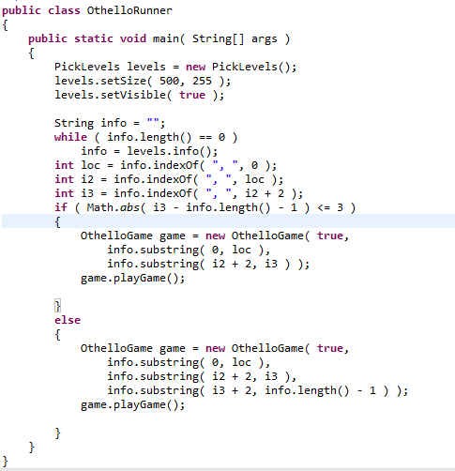
OthelloRunner
OthelloRunner is the actual part of the program that runs
the GUI and game

Slide 23
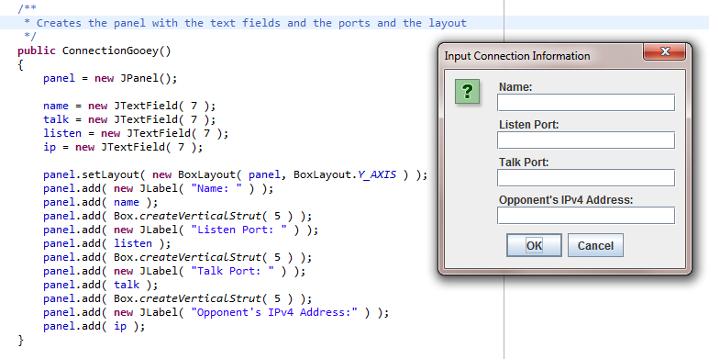
ConnectionGooey
Basically makes the GUI to enter in all the IP addresses and talk/listen ports

Slide 24
Networking Capabilities
Networking is handled by special versions of the game and world called NetworkGame and NetworkWorld
There are sockets

Slide 25
AIs and Human players
All extend an abstract class, OthelloPlayer
All except Impossibru have their own version of getPlay() and the helper methods necessary to calculate what play to make
Impossibru rewrites more, but that’s because this AI is supposed be break the rules of the game

Slide 26
Algorithms!!!

Slide 27
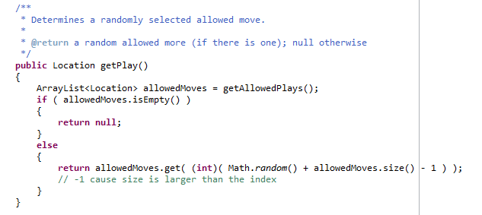
Easy AI
Easy AI literally chooses a random place to play. Nothing to see here folks.

Slide 28
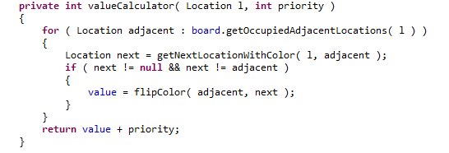
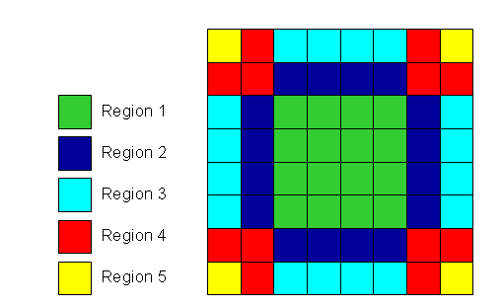
MediumAI
Calculates weighted score of a move
Score = # pieces gained + Location score
Scores for locations are held in an internal map

Slide 29
Hard AI
Implements a crude version of minimax, using negamax
Minimax means that the AI looks ahead, looking for the MAX score given that the opponent is trying to MINImize it.
Negamax uses the fact that the max score is just the negative of the minimum score to speed up calculation.

Slide 30
User Manual

Slide 31
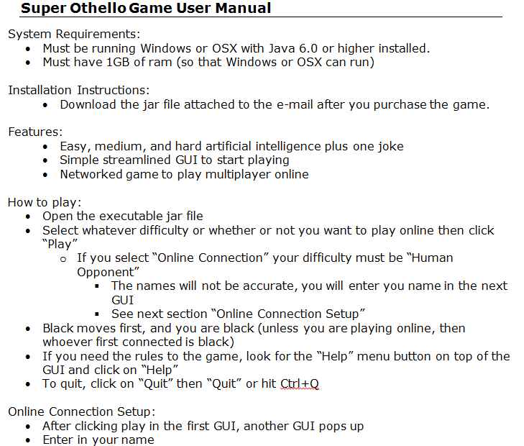
Included in the e-mail with the jar file

Slide 32
Demonstration

